Slide 1

Presented by – Parag Paliwal, Yushan Cai, Vinay Gandhi, Mayuresh Wani, Madhura Pande, Drashti Shah
Sentiment Analysis
on Music App Reviews
Group 2
Notes:
Good evening everyone, I’m Parag. I’m here with my group members Yushan, Vinay, Mayuresh, Madhura, Drashti. We are group 2 and we’re here to present our sentiment analysis on music app review.

Slide 2
Agenda
Motivation
Business Question
Methodology
Analysis
Key Takeaways
Appendix
Sentiment Analysis - Drexel University
Notes:
This is the agenda for our presentation today. During our presentation we will go through the motivation for our business question, then we will discuss our business question. After that we will discuss the methodology we adopted and the analysis we did to answer our business question. And finally we will discuss the key takeaways from our analysis.

Slide 3

Follow the future…
Notes:
Before we deep dive into the business question, Here’s a small video which is one of the motivation behind choosing this business question. After that clip, my team member Yushan will share our business question with you.

Slide 4
Agenda
Motivation
Business Question
Methodology
Analysis
Key Takeaways
Appendix
Sentiment Analysis - Drexel University

Slide 5
What is the impact of artificial intelligence on the music industry?
Sentiment Analysis - Drexel University

Slide 6
Agenda
Motivation
Business Question
Methodology
Analysis
Key Takeaways
Appendix
Sentiment Analysis - Drexel University

Slide 7
Methodology
~39000 consumer reviews analyzed
Platforms – Amazon Music, Pandora and Spotify
Cleaned the reviews
Comment scoring
Word cloud analysis of common terms
Frequency based analysis
Sentiment Analysis - Drexel University
Notes:
Reviews are from the consumers who have used/is using one or more than one of the following music applications – Amazon Music, Pandora and Spotify
We cleaned the data/reviews to standardize the reviews. Mention text mining

Slide 8
Agenda
Motivation
Business Question
Methodology
Analysis
Key Takeaways
Appendix
Sentiment Analysis - Drexel University

Slide 9
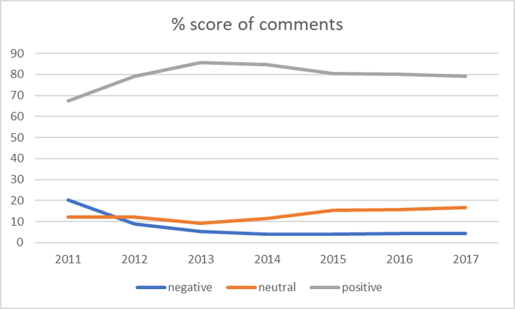


Pandora observes a dip in the negative comments after 2012…
Sentiment Analysis - Drexel University

Slide 10
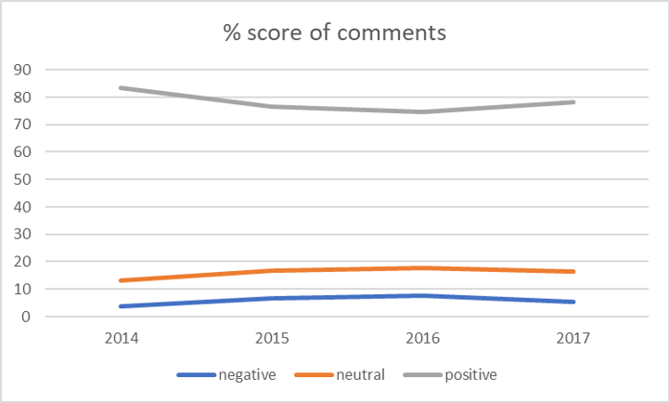

…However, there is an increase in the negative comments for Spotify from 2014 – 2016
Sentiment Analysis - Drexel University

Slide 11
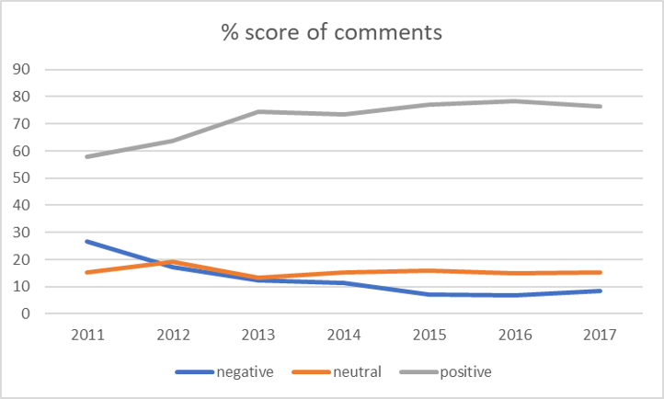

Amazon music manages to garner positive comments over the years…
Sentiment Analysis - Drexel University
Notes:
Word cloud was done to see what the consumers were talking about since 2011 – 2015. And since

Slide 12
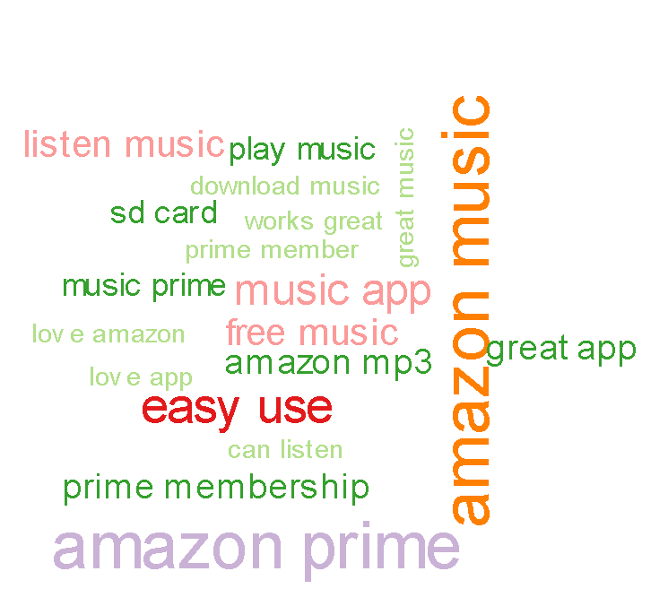
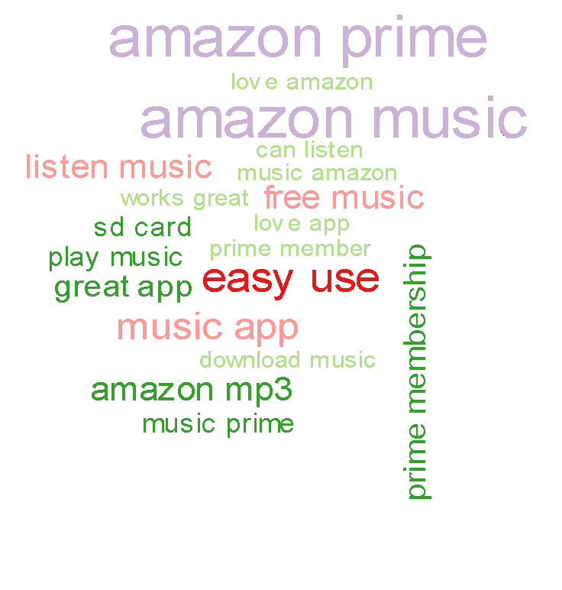
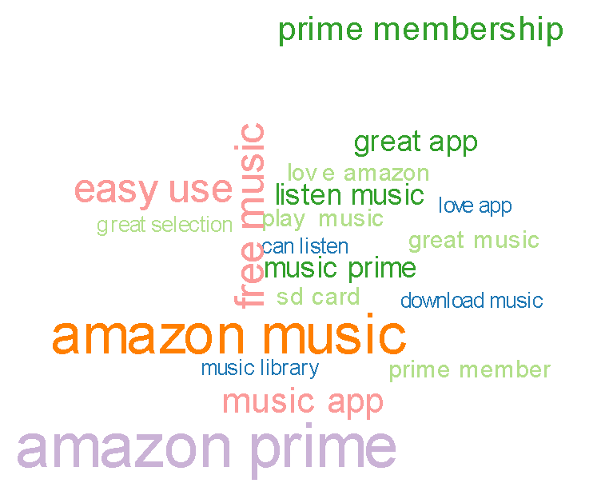
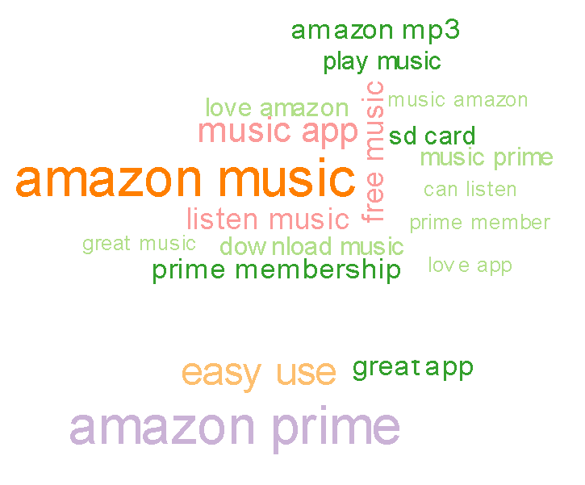
prime music
2012
prime music
prime music
2013
2011
prime music
prime music
2014

Slide 13
…As consumers appreciate Prime Music
“I absolutely love prime music! Great playlists! Very impressed with Amazon. I recommend prime and prime music.”
“Love it! I am very pleased with Prime Music. It's great to get an album free, along with lyrics. Actually, I love everything about Amazon!”
prime music
“Absolutely amazing! Love Prime Music!”
“All I can say is that Amazon Prime music rocks!!”
“Prime Music is the best thing I am getting other than free shipping with my Prime memberships. The playlists are way better than Iheart or Pandora.”
“I love my free Prime Music. There are so many playlists and other good stuff. I even found cool lists for studying. Thanks, Amazon!”
Sentiment Analysis - Drexel University

Slide 14
Amazon scoring
Sentiment Analysis - Drexel University
Notes:
Word cloud was done to see what the consumers were talking about since 2011 – 2015. And since

Slide 15
Some key events of 2015…
NASA confirms the presence of water on Mars
Patriots won the Superbowl championship
Marijuana becomes legal in Washington DC
Sentiment Analysis - Drexel University

Slide 16


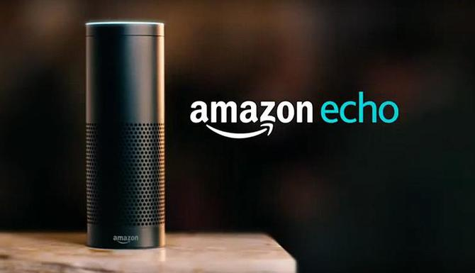
Some more key events in 2015…
Sentiment Analysis - Drexel University

Slide 17
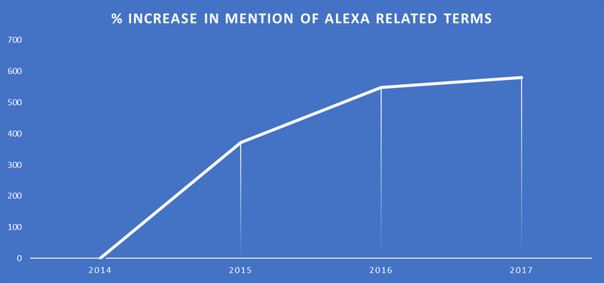
Mentions of AI related terms continue to increase significantly…
Sentiment Analysis - Drexel University

Slide 18
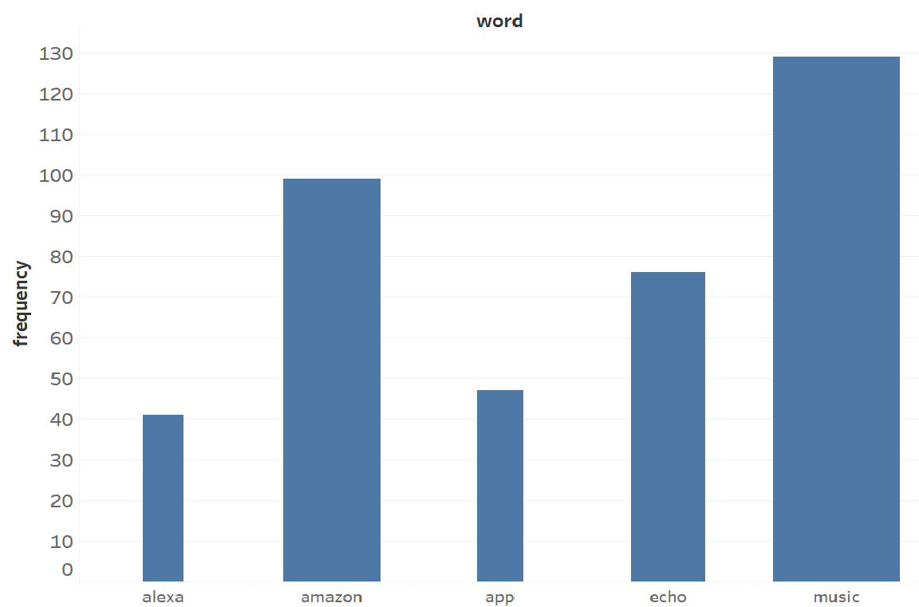
…With AI topping the charts
Sentiment Analysis - Drexel University

Slide 19
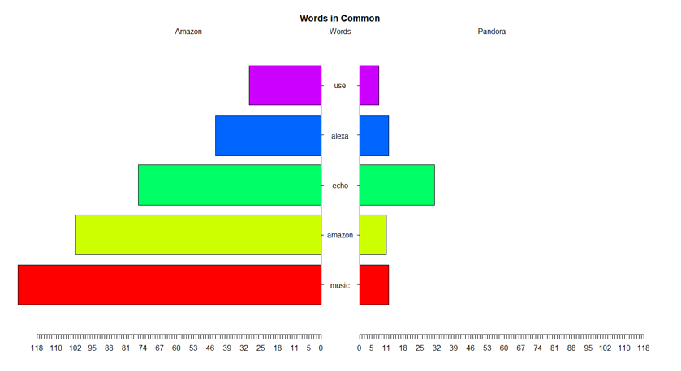
Pandora realizes AI being the need of an hour…
“Pandora is wonderful. Really works well on the Amazon Echo.”
“linked to my Alexa and it's great!”
Sentiment Analysis - Drexel University

Slide 20
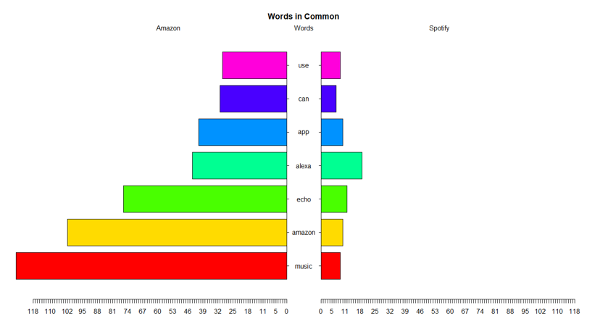
…And Spotify follows the suit
“Spotify + Amazon Echo = frictionless musical bliss.”
“I love being able to play Spotify through Alexa! I just tell her what I want to hear.”
Sentiment Analysis - Drexel University

Slide 21
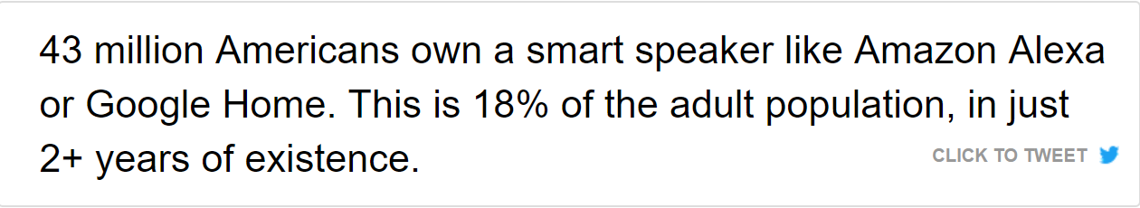
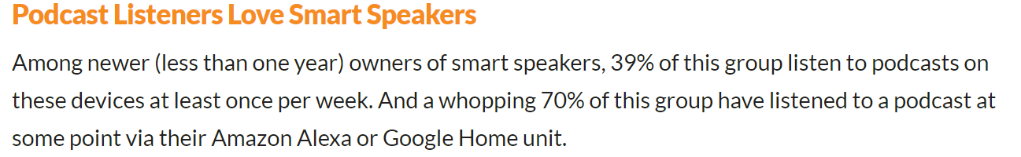
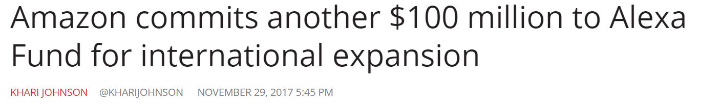
The demand for AI is increasing every minute
Sentiment Analysis - Drexel University

Slide 22
Agenda
Motivation
Business Question
Methodology
Analysis
Key Takeaways
Appendix
Sentiment Analysis - Drexel University

Slide 23
What is the impact of AI on Music Industry?
Personalizes experience – mood detection
Users get exposed to a plethora or artists and genres
Lesser known artists get recognition
Broader demographic - need of mobile phones eliminated
Willingness to pay a premium price
A dip in piracy
Sentiment Analysis - Drexel University

Slide 24

Thank You
Sentiment Analysis - Drexel University

Slide 25
Agenda
Motivation
Business Question
Methodology
Analysis
Key Takeaways
Appendix
Sentiment Analysis - Drexel University

Slide 26
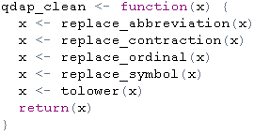
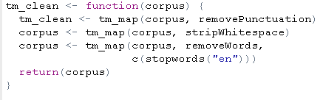
Techniques used to clean the data
Removed stopwords
Removed punctuations
Stripped white space
Replaced abbreviation
Replaced contraction
Replaced ordinal
Replaced symbol
Changed to lower case
Sentiment Analysis - Drexel University

Slide 27
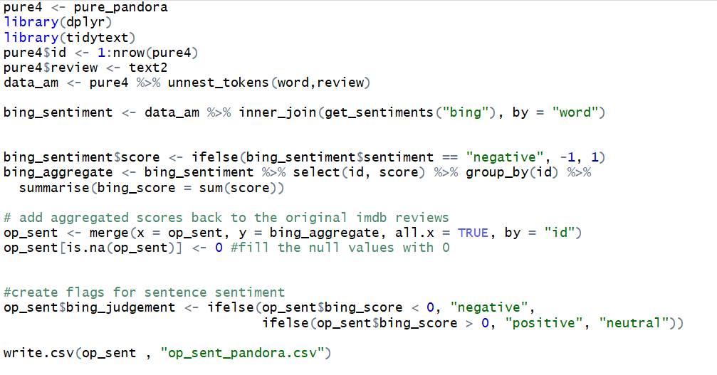
Scoring / Polarity

Slide 28
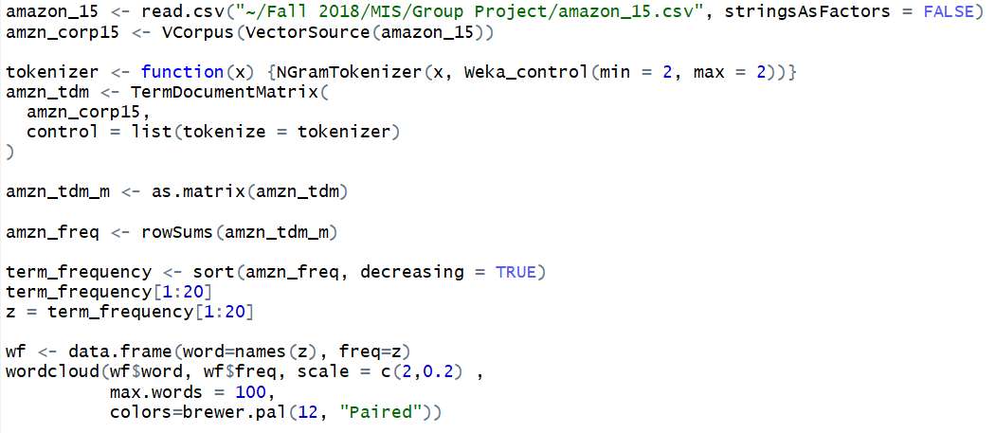
Word Cloud Analysis

Slide 29
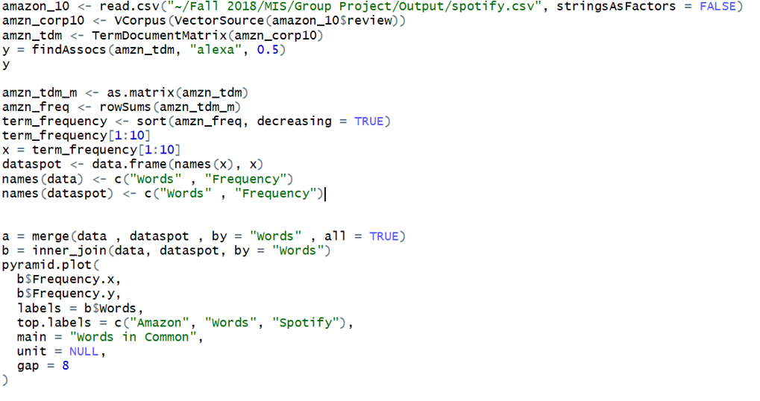
Comparison

